Slide 1
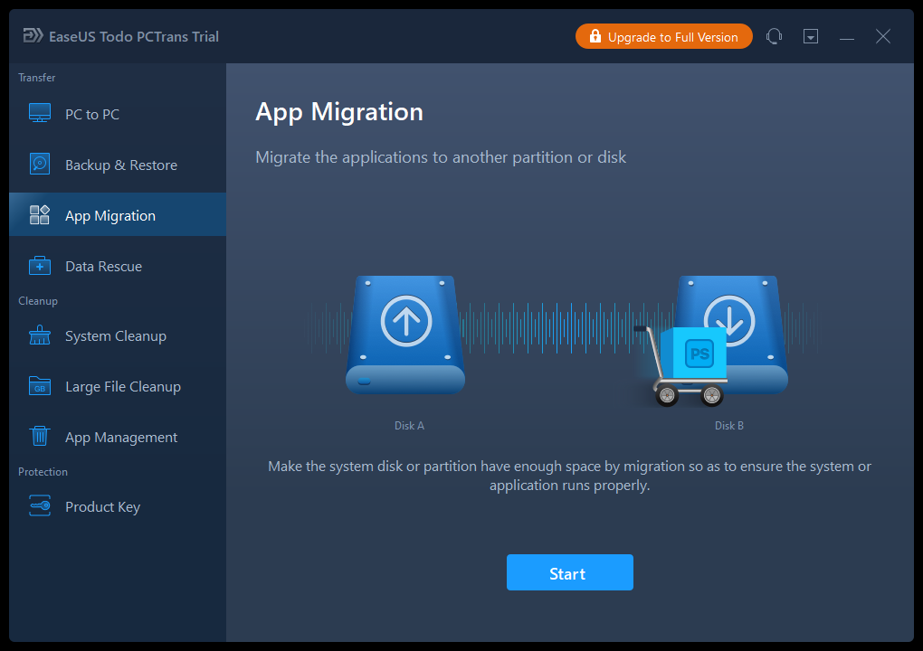
DISK CLONING
WE SHALL BE USING EASEUS SOFTWARE TO PERFORM THIS PRESENTATION HOWEVER THERE ARE MANY OTHER SOFTWARES THAT WE CAN USE.
IN THIS CASE WE ARE USING THE FREE VERSION WHICH IS LIMITED BUT IN FEATURE ONE CAN CHOSE TO UPGRADE

Slide 2
STEP1: OPEN EASEUS SOFTWARE, THEN SELECT THE APP MIGRATION OPTION

Slide 3
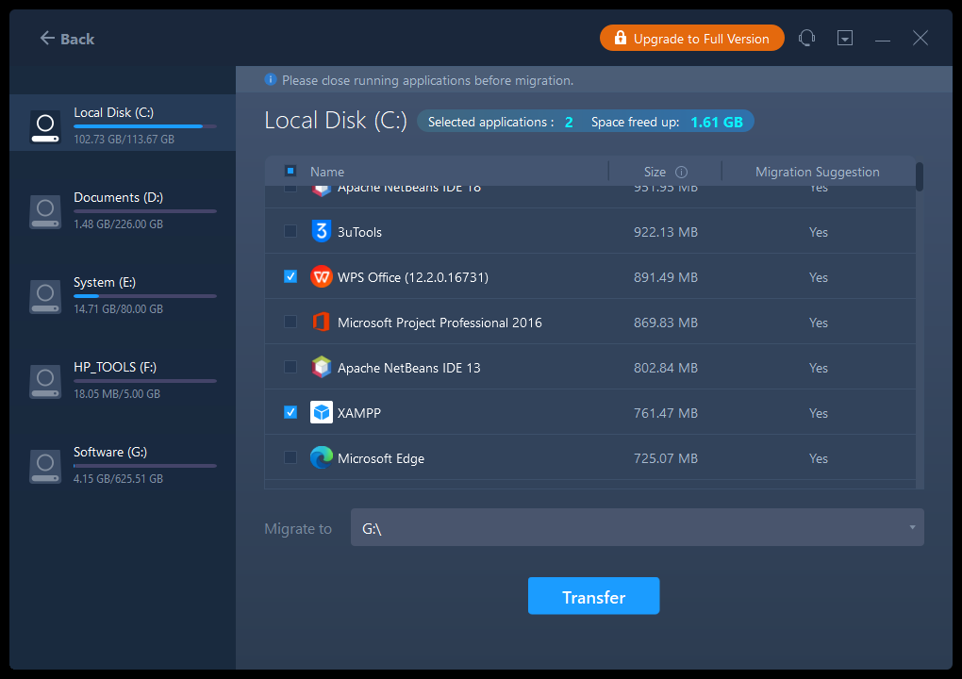
STEP 2: START SELECTING THE FILES TO TRANSFER, FOLLOWING WITH PRESSING THE TRANSFER BUTTON

Slide 4
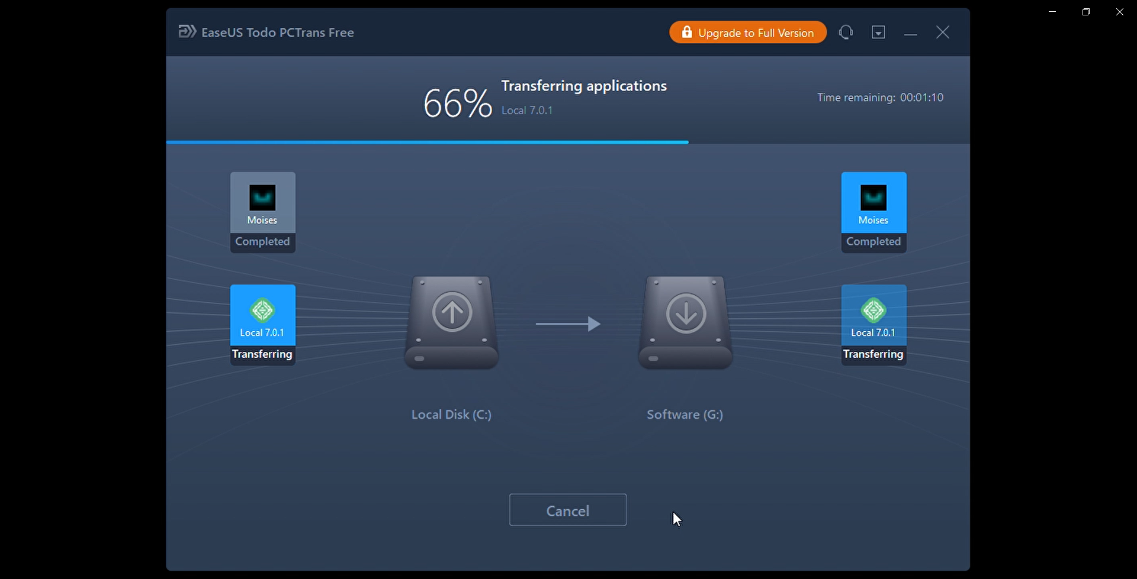
STEP 3: CLICK ON TRANSFER BUTTON TO START TRANSFERING, AT THIS POINT ALL YOU HAVE TO DO IS WAIT FOR THE FILES TO TRANSFER.

Slide 5
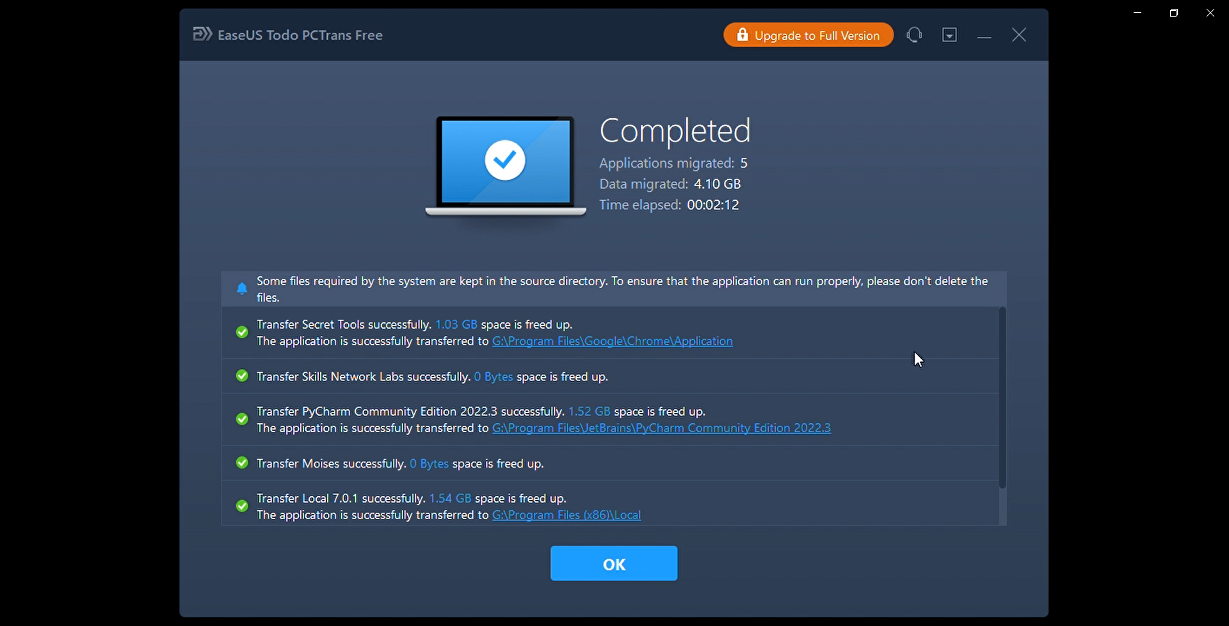
STEP 4: WHEN THE TRANSFER PROCESS IS DONE PRESS OKEY AND THEN RESTART YOUR COMPUTER.

